Slide 2
Steps in the Policy Analysis Process
Define and analyze the problem (Ch. 5)
Construct policy alternatives (Ch. 5)
Develop evaluative criteria (Ch. 6)
Assess policy alternatives (Ch. 6)
Draw conclusions (Ch. 6)

Slide 3
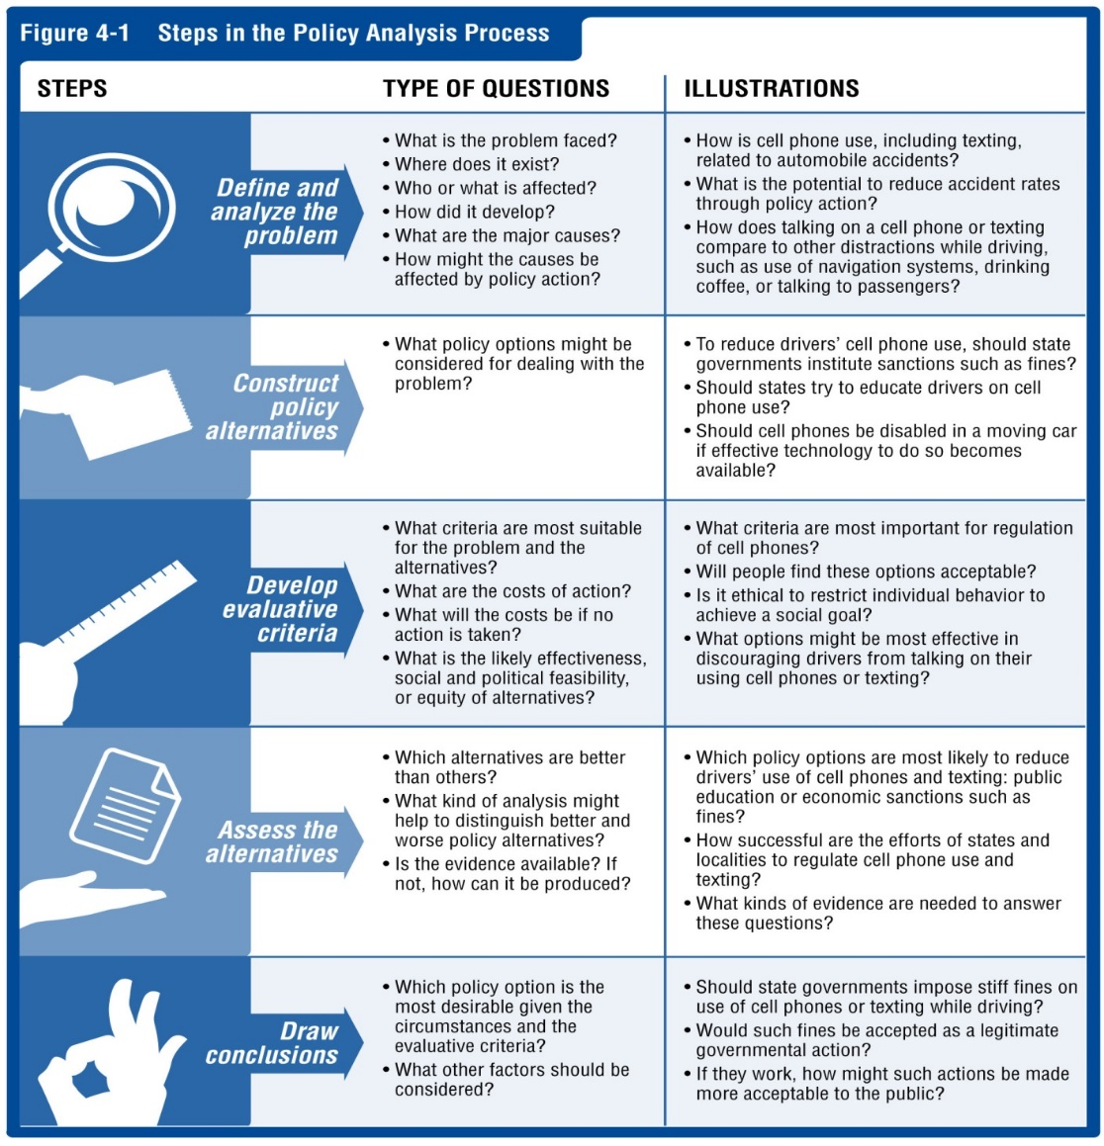

Slide 4
Assess Policy Alternatives
Which alternative is likely to be most effective?
Which alternative best meets the standards of your evaluative criteria?
Which combination of policies might work well together?
What will the impact be on the problem of each course of action?

Slide 5
Draw Conclusions: Propose a Policy
In Step 4, you assessed the various options (developed in Step 2) according to your evaluative criteria (chosen in Step 3).
Based on your Step 4 assessment, which policy do you propose as “best?”

